Slide 1
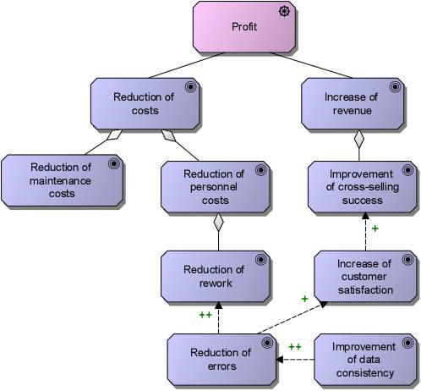
Driver and Goal Diagram

Slide 2
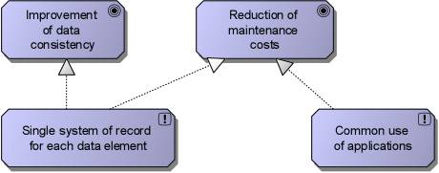
Driver and Goal Diagram

Slide 3
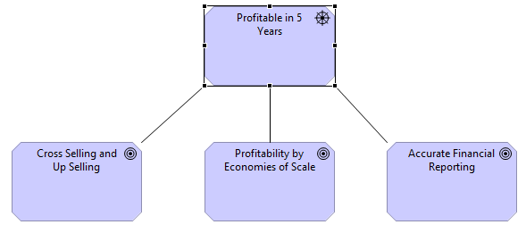
Driver and Goal Diagram

